Slide 1


Lesson 8:Let’s Paint!

Slide 2




Traditional Drawing

Slide 3
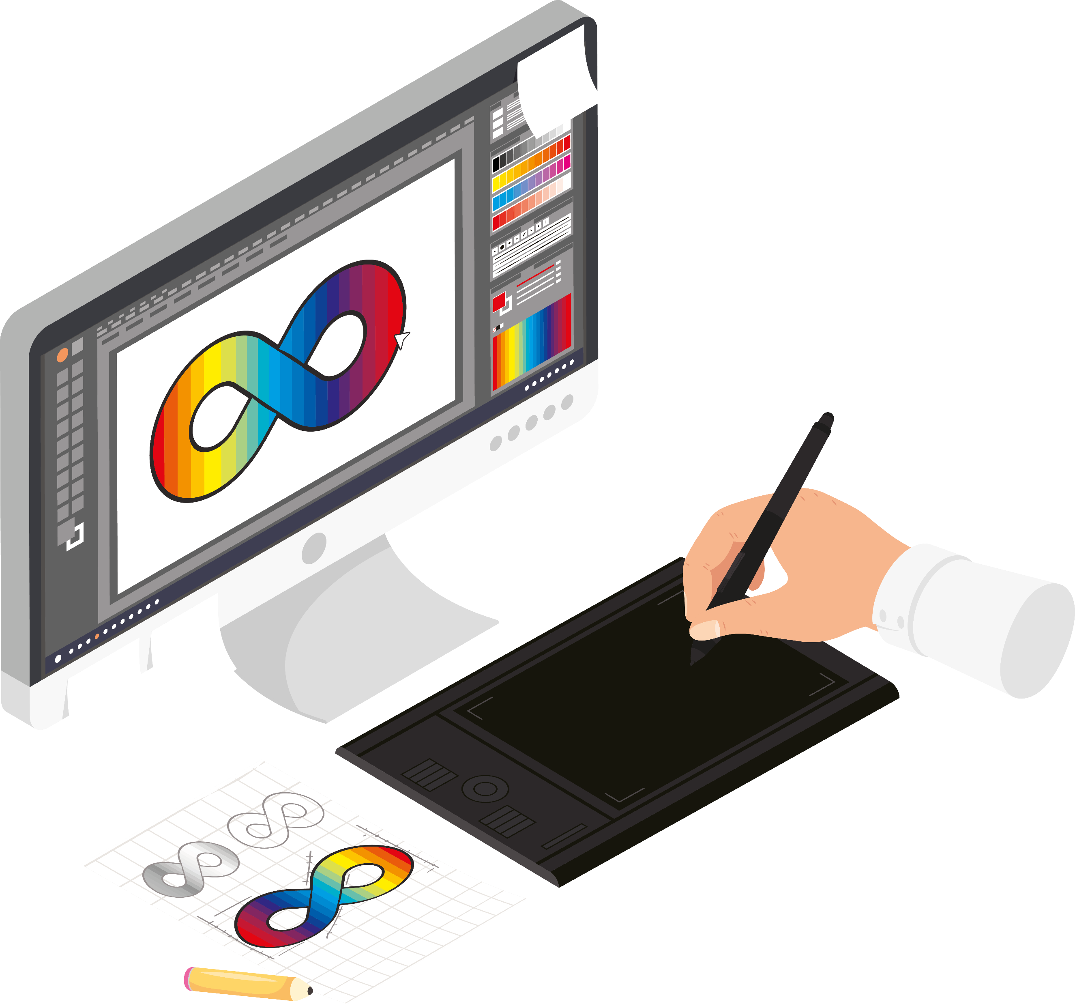
Digital Drawing

Slide 4
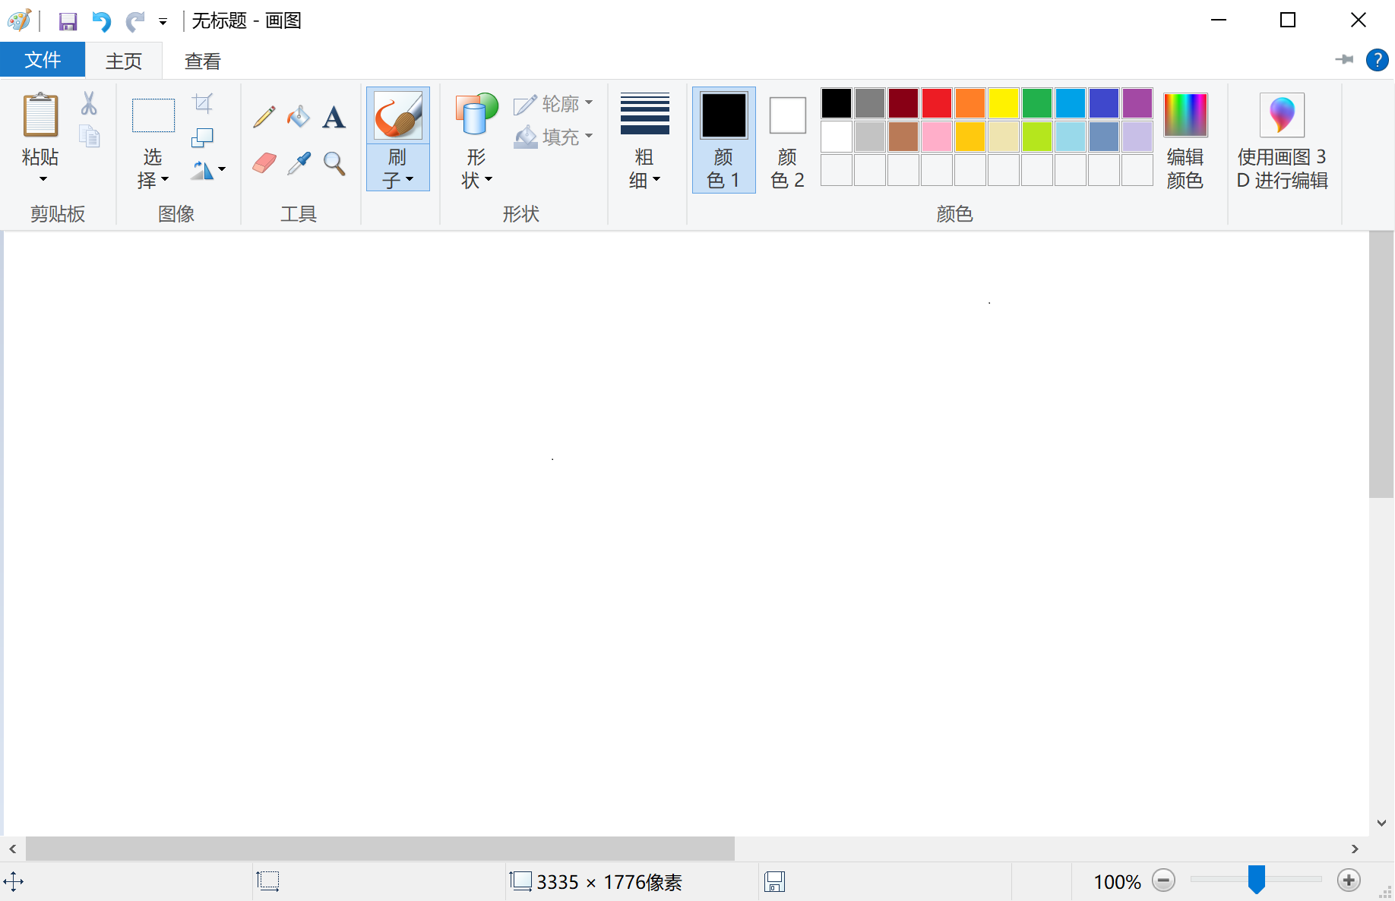

Microsoft Paint

Slide 5
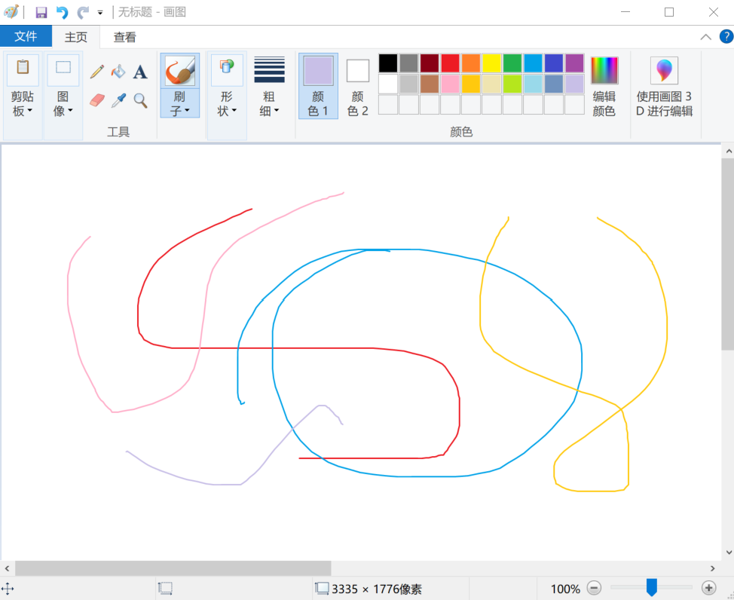
Draw
s

Slide 6

Erase

Slide 7
Slide

Slide 8
Slide

Slide 9
Slide

Slide 10
Slide

Slide 11
Slide

Slide 12
Slide

Slide 13
Slide

Slide 14
Slide

Slide 15
Slide

Slide 16
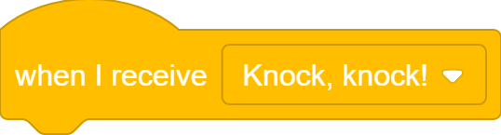
What we learnt…
How to receive messages in Scratch

Slide 17
Exercises
Can you find more real-world examples of one-to-one communication and message broadcasting?
Create a longer conversation (could be a different joke or even a whole story) between more than two sprites. Use the Say-and-Wait approach first, then use Message Broadcasting. Compare the two approaches and truly appreciate why message broadcasting makes your life easier.

Slide 18
Thank you and see you in the next lesson!

